Slide 1
Reporting Aggregated Data
Using the Group Functions
Lesson 5
5-<number>

Slide 2

What You will learn at the end of the Session?
  Identify the available group functions
4
3
  Describe the use of group functions.
2
1
  Group data by using the GROUP BY clause
3.
4.
  Include or exclude grouped rows by using the HAVING clause
5-<number>
Notes:
What you will learn at the end of this Session?
This lesson further addresses functions. It focuses on obtaining summary information (such as averages) for groups of rows. It discusses how to group rows in a table into smaller sets and how to specify search criteria for groups of rows.

Slide 3

Session Plan
  Group functions:
    Types and syntax
    Use AVG, SUM, MIN, MAX, COUNT
    Use the DISTINCT keyword within group functions
    NULL values in a group function
Group functions
  Grouping rows
  Grouping rows:
  GROUP BY clause
  HAVING clause
  Nesting group functions
  Nesting group functions
5-<number>

Slide 4
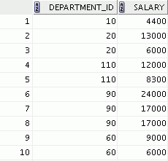


What Are Group Functions?
Group functions operate on sets of rows to give one result per group.
EMPLOYEES
Maximum salary in EMPLOYEES table
…
5-<number>
Notes:
Oracle Database: SQL Fundamentals I 5 - <number>
What Are Group Functions?
Unlike single-row functions, group functions operate on sets of rows to give one result per group. These sets may comprise the entire table or the table split into groups.

Slide 5
Types of Group Functions
  AVG
  COUNT
  MAX
  MIN
  STDDEV
  SUM
  VARIANCE
Group
functions
5-<number>
Notes:
Oracle Database: SQL Fundamentals I 5 - <number>
Types of Group Functions
Each of the functions accepts an argument. The following table identifies the options that you can use in the syntax:

Slide 6
Group Functions: Syntax
SELECT group_function(column), ...
FROM table
[WHERE condition]
[ORDER BY column];
5-<number>
Notes:
Oracle Database: SQL Fundamentals I 5 - <number>
Group Functions: Syntax
The group function is placed after the SELECT keyword. You may have multiple group functions separated by commas.
Guidelines for using the group functions:
DISTINCT makes the function consider only nonduplicate values; ALL makes it consider every value, including duplicates. The default is ALL and, therefore, does not need to be specified.
The data types for the functions with an expr argument may be CHAR, VARCHAR2, NUMBER, or DATE.
All group functions ignore null values. To substitute a value for null values, use the NVL, NVL2, COALESCE, CASE, or DECODE functions.

Slide 7

Using the AVG and SUM Functions
You can use AVG and SUM for numeric data.
AVG
Numeric Data
SUM
SELECT AVG(order_total), MAX(order_total),
MIN (order_total), SUM( order_total)
FROM orders;
5-<number>
Notes:
Oracle Database: SQL Fundamentals I 5 - <number>
Using the AVG and SUM Functions
You can use the AVG, SUM, MIN, and MAX functions against the columns that can store numeric data. The example in the slide displays the average, highest, lowest, and sum of the total value of each order.

Slide 8


Using the MIN and MAX Functions
You can use MIN and MAX for numeric, character, and date data types.
Numeric, Character, and Date Data types
MIN
MAX
SELECT MIN(to_char(order_date, 'fmDD Month YYYY'))
AS "Min Order Date",
MAX(to_char(order_date, 'fmDD Month YYYY'))
AS "Max Order Date"
FROM orders ;
5-<number>
Notes:
Oracle Database: SQL Fundamentals I 5 - <number>
Using the MIN and MAX Functions
You can use the MAX and MIN functions for numeric, character, and date data types. The example in the slide displays the oldest and the latest orders.
The following example displays the employee last name that is first and the employee last name that is last in an alphabetic list of all employees:
SELECT MIN(last_name), MAX(last_name)
FROM employees;
Note: The AVG, SUM, VARIANCE, and STDDEV functions can be used only with numeric data types. MAX and MIN cannot be used with LOB or LONG data types.

Slide 9


Using the COUNT Function
COUNT(*) returns the number of rows in a table:
COUNT(expr) returns the number of rows with non-null values for expr:
SELECT count(*)
FROM inventories
WHERE warehouse_id = 8;
1
SELECT COUNT(sales_rep_id)
FROM orders
WHERE order_status <=3;
2
5-<number>
Notes:
Oracle Database: SQL Fundamentals I 5 - <number>
Using the COUNT Function
The COUNT function has three formats:
COUNT(*)
COUNT(expr)
COUNT(DISTINCT expr)
COUNT(*) returns the number of rows in a table that satisfy the criteria of the SELECT statement, including duplicate rows and rows containing null values in any of the columns. If a WHERE clause is included in the SELECT statement, COUNT(*) returns the number of rows that satisfy the condition in the WHERE clause.
In contrast, COUNT(expr) returns the number of non-null values that are in the column identified by expr.
COUNT(DISTINCT expr) returns the number of unique, non-null values that are in the column identified by expr.
Examples:
1. The example in the slide displays the number of orders in warehouse 8.
2. The example in the slide displays the number of orders with status <= 3 and whose sales_rep_id is not null.

Slide 10

Using the DISTINCT Keyword
  COUNT(DISTINCT expr) returns the number of distinct non-null values of expr.
  To display the number of distinct department values in the EMPLOYEES table:
SELECT COUNT(DISTINCT department_id)
FROM employees;
5-<number>
Notes:
Oracle Database: SQL Fundamentals I 5 - <number>
Using the DISTINCT Keyword
Use the DISTINCT keyword to suppress the counting of any duplicate values in a column.
The example in the slide displays the number of distinct department values that are in the EMPLOYEES table.

Slide 11


Group Functions and Null Values
Group functions ignore null values in the column:
The NVL function forces group functions to include null values:
1
SELECT AVG(commission_pct)
FROM employees;
2
SELECT AVG(NVL(commission_pct, 0))
FROM employees;
5-<number>
Notes:
Oracle Database: SQL Fundamentals I 5 - <number>
Group Functions and Null Values
All group functions ignore null values in the column.
However, the NVL function forces group functions to include null values.
Examples:
1. The average is calculated based on only those rows in the table in which a valid value is stored in the COMMISSION_PCT column. The average is calculated as the total commission that is paid to all employees divided by the number of employees receiving a commission (four).
2. The average is calculated based on all rows in the table, regardless of whether null values are stored in the COMMISSION_PCT column. The average is calculated as the total commission that is paid to all employees divided by the total number of employees in the company (20).

Slide 12
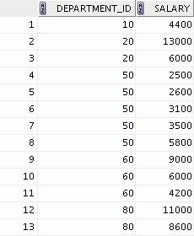
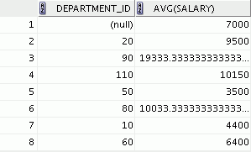

Creating Groups of Data
EMPLOYEES
Average salary in the
EMPLOYEES table for
each department
4400
9500
3500
6400
10033
…
5-<number>
Notes:
Oracle Database: SQL Fundamentals I 5 - <number>
Creating Groups of Data
Until this point in the discussion, all group functions have treated the table as one large group of information. At times, however, you need to divide the table of information into smaller groups. This can be done by using the GROUP BY clause.

Slide 13
Creating Groups of Data: GROUP BY Clause Syntax
You can divide rows in a table into smaller groups by using the GROUP BY clause.
SELECT column, group_function(column)
FROM table
[WHERE condition]
[GROUP BY group_by_expression]
[ORDER BY column];
5-<number>
Notes:
Oracle Database: SQL Fundamentals I 5 - <number>
Creating Groups of Data: GROUP BY Clause Syntax
You can use the GROUP BY clause to divide the rows in a table into groups. You can then use the group functions to return summary information for each group.
In the syntax:
group_by_expression Specifies the columns whose values determine the basis for
grouping rows
Guidelines
If you include a group function in a SELECT clause, you cannot select individual results as well, unless the individual column appears in the GROUP BY clause. You receive an error message if you fail to include the column list in the GROUP BY clause.
Using a WHERE clause, you can exclude rows before dividing them into groups.
You must include the columns in the GROUP BY clause.
You cannot use a column alias in the GROUP BY clause.

Slide 14
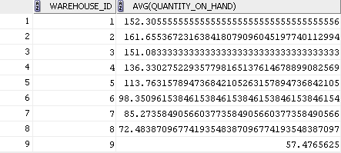
Using the GROUP BY Clause
All the columns in the SELECT list that are not in group functions must be in the GROUP BY clause.
SELECT warehouse_id, AVG(quantity_on_hand)
FROM inventories
GROUP BY warehouse_id ;
5-<number>
Notes:
Oracle Database: SQL Fundamentals I 5 - <number>
Using the GROUP BY Clause
When using the GROUP BY clause, make sure that all columns in the SELECT list that are not group functions are included in the GROUP BY clause. The example in the slide displays the department number and the average salary for each department. Here is how this SELECT statement, containing a GROUP BY clause, is evaluated:
The SELECT clause specifies the columns to be retrieved, as follows:
Warehouse ID column in the INVENTORIES table.
The average of quantity on hand in the group that you specified in the GROUP BY clause
The FROM clause specifies the tables that the database must access: the INVENTORIES table.
The WHERE clause specifies the rows to be retrieved. Because there is no WHERE clause, all rows are retrieved by default.
The GROUP BY clause specifies how the rows should be grouped. The rows are grouped by warehouse_id column, so the AVG function that is applied to the quantity_on_hand column which calculates the average quantity_on_hand for each department.
Note: To order the query results in ascending or descending order, include the ORDER BY clause in the query.

Slide 15
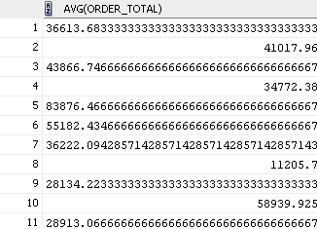
Using the GROUP BY Clause
The GROUP BY column does not have to be in the SELECT list.
SELECT AVG(order_total)
FROM orders
GROUP BY order_status ;
5-<number>
Notes:
Oracle Database: SQL Fundamentals I 5 - <number>
Using the GROUP BY Clause (continued)
The GROUP BY column does not have to be in the SELECT clause. For example, the SELECT statement in the slide displays the average order value for each order status without displaying the respective status. Without the status, however, the results do not look meaningful.
You can also use the group function in the ORDER BY clause:
SELECT order_status, AVG(order_total)
FROM orders
GROUP BY order_status
ORDER BY AVG(order_total);
…

Slide 16
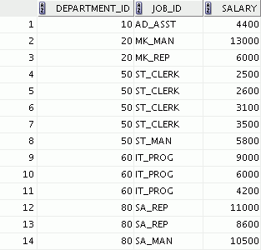
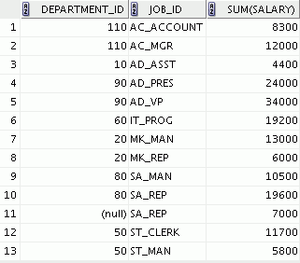

Grouping by More Than One Column
EMPLOYEES
Add the salaries in the EMPLOYEES
table for each job, grouped by
department.
…
5-<number>
Notes:
Oracle Database: SQL Fundamentals I 5 - <number>
Grouping by More Than One Column
Sometimes, you need to see results for groups within groups. The slide shows a report that displays the total salary that is paid to each job title in each department.
The EMPLOYEES table is grouped first by the department number, and then by the job title within that grouping. For example, the four stock clerks in department 50 are grouped together, and a single result (total salary) is produced for all stock clerks in the group.
The following SELECT statement returns the result shown in the slide:
SELECT department_id, job_id, sum(salary)
FROM employees
GROUP BY department_id, job_id
ORDER BY job_id;

Slide 17


Using the GROUP BY Clause on Multiple Columns
SELECT order_mode, order_status, sum(order_total)
FROM orders
WHERE order_id BETWEEN 2300 AND 2500
GROUP BY order_mode, order_status
ORDER BY order_mode, order_status ;
…
…
…
5-<number>
Notes:
Oracle Database: SQL Fundamentals I 5 - <number>
Using the Group By Clause on Multiple Columns
You can return summary results for groups and subgroups by listing multiple GROUP BY columns. The GROUP BY clause groups rows but does not guarantee the order of the result set. To order the groupings, use the ORDER BY clause.
In the example in the slide, the SELECT statement that contains a GROUP BY clause is evaluated as follows:
The SELECT clause specifies the column to be retrieved:
order_mode in the ORDERS table
order_status in the ORDERS table
The sum of all order_total in the group that you specified in the GROUP BY clause
The FROM clause specifies the tables that the database must access: the ORDERS table.
The WHERE clause reduces the result set to those rows where order_id is between 2300 and 2500.
The GROUP BY clause specifies how you must group the resulting rows:
First, the rows are grouped by the order_mode.
Second, the rows are grouped by order_status in the order_mode groups.
The ORDER BY clause sorts the results by order_mode and order_status.

Slide 18


Illegal Queries Using Group Functions
Any column or expression in the SELECT list that is not an aggregate function must be in the GROUP BY clause:
SELECT department_id, COUNT(last_name)
FROM employees;
A GROUP BY clause must be added to count the last names for each department_id.
SELECT department_id, job_id, COUNT(last_name)
FROM employees
GROUP BY department_id;
Either add job_id in the GROUP BY or remove the job_id column from the SELECT list.
5-<number>
Notes:
Oracle Database: SQL Fundamentals I 5 - <number>
Illegal Queries Using Group Functions
Whenever you use a mixture of individual items (DEPARTMENT_ID) and group functions (COUNT) in the same SELECT statement, you must include a GROUP BY clause that specifies the individual items (in this case, DEPARTMENT_ID). If the GROUP BY clause is missing, the error message “not a single-group group function” appears and an asterisk (*) points to the offending column. You can correct the error in the first example in the slide by adding the GROUP BY clause:
SELECT department_id, count(last_name)
FROM employees
GROUP BY department_id;
Any column or expression in the SELECT list that is not an aggregate function must be in the GROUP BY clause. In the second example in the slide, job_id is neither in the GROUP BY clause nor is it being used by a group function, so there is a “not a GROUP BY expression” error. You can correct the error in the second slide example by adding job_id in the GROUP BY clause.
SELECT department_id, job_id, COUNT(last_name)
FROM employees
GROUP BY department_id, job_id;

Slide 19
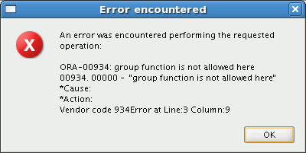
Illegal Queries Using Group Functions
  You cannot use the WHERE clause to restrict groups.
  You use the HAVING clause to restrict groups.
  You cannot use group functions in the WHERE clause.
SELECT department_id, AVG(salary)
FROM employees
WHERE AVG(salary) > 8000
GROUP BY department_id;
Cannot use the WHERE clause to restrict groups
5-<number>
Notes:
Oracle Database: SQL Fundamentals I 5 - <number>
Illegal Queries Using Group Functions (continued)
The WHERE clause cannot be used to restrict groups. The SELECT statement in the example in the slide results in an error because it uses the WHERE clause to restrict the display of the average salaries of those departments that have an average salary greater than $8,000.
However, you can correct the error in the example by using the HAVING clause to restrict groups:
SELECT department_id, AVG(salary)
FROM employees
GROUP BY department_id
HAVING AVG(salary) > 8000;

Slide 20
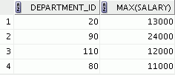
Restricting Group Results
EMPLOYEES
The maximum salary per department when it is
greater than $10,000
…
5-<number>
Notes:
Oracle Database: SQL Fundamentals I 5 - <number>
Restricting Group Results
You use the HAVING clause to restrict groups in the same way that you use the WHERE clause to restrict the rows that you select. To find the maximum salary in each of the departments that have a maximum salary greater than $10,000, you need to do the following:
1. Find the average salary for each department by grouping by department number.
2. Restrict the groups to those departments with a maximum salary greater than $10,000.

Slide 21
Restricting Group Results with the HAVING Clause
When you use the HAVING clause, the Oracle server restricts groups as follows:
  Rows are grouped.
  The group function is applied.
  Groups matching the HAVING clause are displayed.
SELECT column, group_function
FROM table
[WHERE condition]
[GROUP BY group_by_expression]
[HAVING group_condition]
[ORDER BY column];
5-<number>
Notes:
Oracle Database: SQL Fundamentals I 5 - <number>
Restricting Group Results with the HAVING Clause
You use the HAVING clause to specify the groups that are to be displayed, thus further restricting the groups on the basis of aggregate information.
In the syntax, group_condition restricts the groups of rows returned to those groups for which the specified condition is true.
The Oracle server performs the following steps when you use the HAVING clause:
1. Rows are grouped.
2. The group function is applied to the group.
3. The groups that match the criteria in the HAVING clause are displayed.
The HAVING clause can precede the GROUP BY clause, but it is recommended that you place the GROUP BY clause first because it is more logical. Groups are formed and group functions are calculated before the HAVING clause is applied to the groups in the SELECT list.
Note: The WHERE clause restricts rows, whereas the HAVING clause restricts groups.

Slide 22
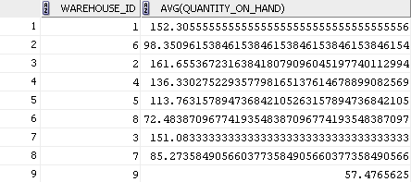
Using the HAVING Clause
SELECT warehouse_id, AVG(quantity_on_hand)
FROM inventories
GROUP BY warehouse_id
HAVING MAX (quantity_on_hand) > 130 ;
5-<number>
Notes:
Oracle Database: SQL Fundamentals I 5 - <number>
Using the HAVING Clause
The example in the slide displays the warehouse ID and average quantity on hand for those warehouses with a maximum quantity greater than 130 130.
You can use the GROUP BY clause without using a group function in the SELECT list. If you restrict rows based on the result of a group function, you must have a GROUP BY clause as well as the HAVING clause.
The following example displays the department numbers and average salaries for those departments with a maximum salary greater than $10,000:
SELECT department_id, AVG(salary)
FROM employees
GROUP BY department_id
HAVING max(salary)>10000;

Slide 23

Using the HAVING Clause
SELECT job_id, SUM(salary) PAYROLL
FROM employees
WHERE job_id NOT LIKE '%REP%'
GROUP BY job_id
HAVING SUM(salary) > 13000
ORDER BY SUM(salary);
5-<number>
Notes:
Oracle Database: SQL Fundamentals I 5 - <number>
Using the HAVING Clause (continued)
The example in the slide displays the job ID and total monthly salary for each job that has a total payroll exceeding $13,000. The example excludes sales representatives and sorts the list by the total monthly salary.

Slide 24

Nesting Group Functions
Display the maximum average salary:
SELECT MAX(AVG(order_total))
FROM orders
GROUP BY order_status;
5-<number>
Notes:
Oracle Database: SQL Fundamentals I 5 - <number>
Nesting Group Functions
Group functions can be nested to a depth of two functions. The example in the slide calculates the average total order for each status and then displays the maximum average order toal.
Note that GROUP BY clause is mandatory when nesting group functions.

Slide 25
Quiz
Identify the guidelines for group functions and the GROUP BY clause.
  You cannot use a column alias in the GROUP BY clause.
  The GROUP BY column must be in the SELECT clause.
  By using a WHERE clause, you can exclude rows before dividing them into groups.
  The GROUP BY clause groups rows and ensures order of the result set.
  If you include a group function in a SELECT clause, you cannot select individual results as well.
5-<number>
Notes:
Oracle Database: SQL Fundamentals I 5 - <number>
Answer: 1, 3

Slide 26

Session Summary
1.
  Use the group functions COUNT, MAX, MIN, SUM, and AVG
1
2
3
  Write queries that use the GROUP BY clause
2.
  Write queries that use the HAVING clause
SELECT column, group_function
FROM table
[WHERE condition]
[GROUP BY group_by_expression]
[HAVING group_condition]
[ORDER BY column];
3.
5-<number>
Notes:
Summary
There are several group functions available in SQL, such as AVG, COUNT, MAX, MIN, SUM, STDDEV, and VARIANCE.
You can create subgroups by using the GROUP BY clause. Further, groups can be restricted using the HAVING clause.
Place the HAVING and GROUP BY clauses after the WHERE clause in a statement. The order of the GROUP BY and HAVING clauses following the WHERE clause is not important. Place the ORDER BY clause at the end.
The Oracle server evaluates the clauses in the following order:
1. If the statement contains a WHERE clause, the server establishes the candidate rows.
2. The server identifies the groups that are specified in the GROUP BY clause.
3. The HAVING clause further restricts result groups that do not meet the group criteria in the HAVING clause.
Note: For a complete list of the group functions, see Oracle Database SQL Language Reference for 10g or 11g database.

Slide 27

Practice 5: Overview
This practice covers the following topics:
  Writing queries that use the group functions
Writing queries
Practice 5: Overview
HAVING clause
Grouping
  Grouping by rows to achieve more than one result
  Restricting groups by using the HAVING clause
5-<number>
Notes:
Oracle Database: SQL Fundamentals I 5 - <number>
Practice 5: Overview
In this practice, you learn to use group functions and select groups of data.

